Slide 1
MS New Releases Site Usage for RGY
Instructions & Design
04/13/21

Slide 2
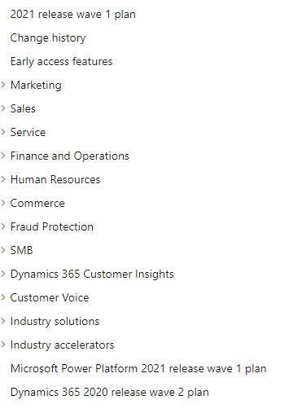
Order/Set up for Main Wheel
*breakdown of current RGY sheets/product columns
CE Ring (unique color)
Marketing
Sales
Break “Service” into Field Service & Customer Service
FS Ring (unique color)
Finance
Supply Chain
Commerce
Put Fraud Protection under Commerce
Project Operations
SMB = BC Ring (unique color)
Additional Products (unique color)
Human Resources
D365 Customer Insights
Customer Voice
FS Guides
Power Platform Ring (keep separate or but under additional?)
Skip Industry Solutions & Accelerators
https://docs.microsoft.com/en-us/dynamics365-release-plan/2021wave1/

Slide 3
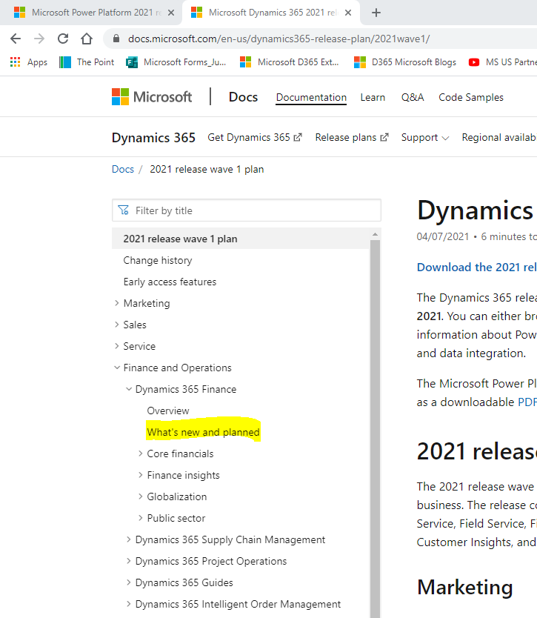
From this main page, I would navigate to “what’s new” for each product. That is how I built each row of the report.
https://docs.microsoft.com/en-us/dynamics365-release-plan/2021wave1/

Slide 4
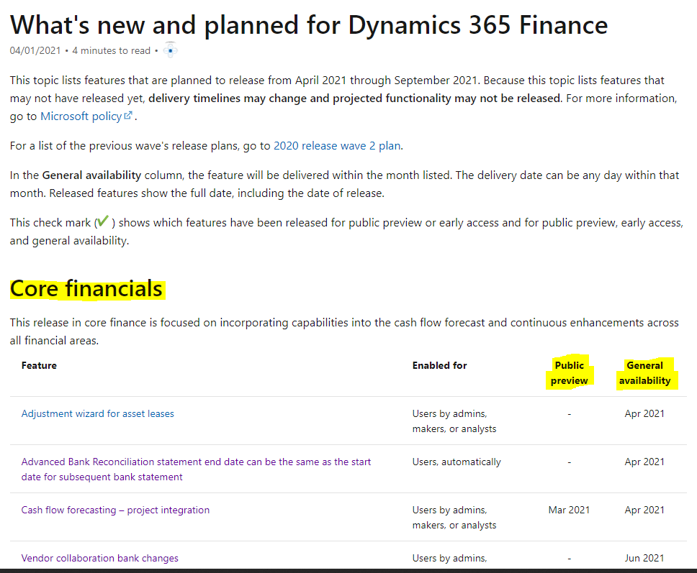
The section breaks/categories noted by MS are what I used in the RGY report as “Sub Category” column
Upgrade Summary = Title of the feature
Used both of these dates in report (if blank on site, I left the cell blank)
https://docs.microsoft.com/en-us/dynamics365-release-plan/2021wave1/finance-operations/dynamics365-finance/planned-features

Slide 5
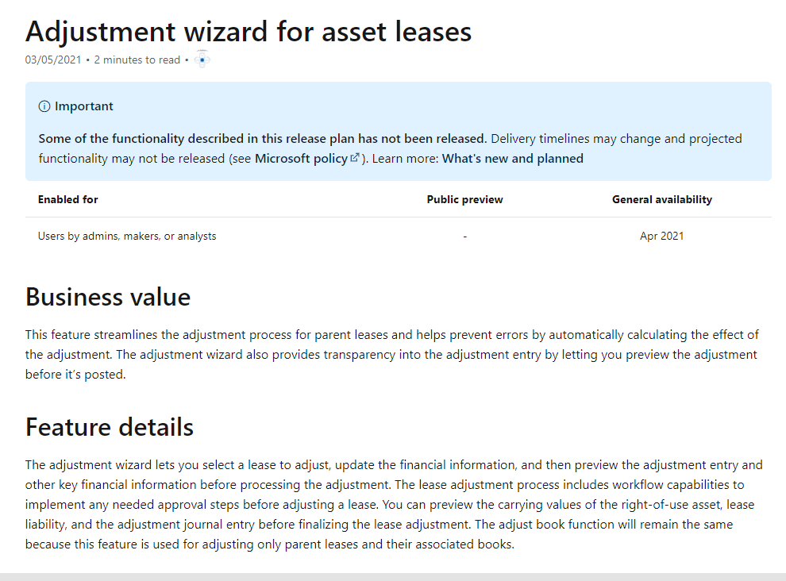
The “business value” column of report is a summary of these two sections. For the wheel, I would say link business value as a hover description and feature details as a side info section once the node is clicked on?

Slide 6
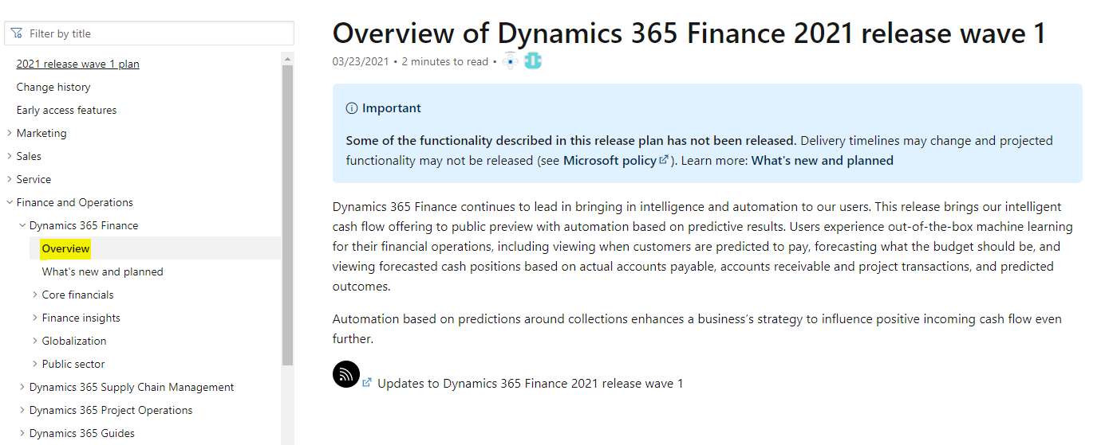
MS typically provides a brief overview for each product section, so it might be nice to have this as a side box when you click on the larger product nodes (prior to getting into specific features)

Slide 7
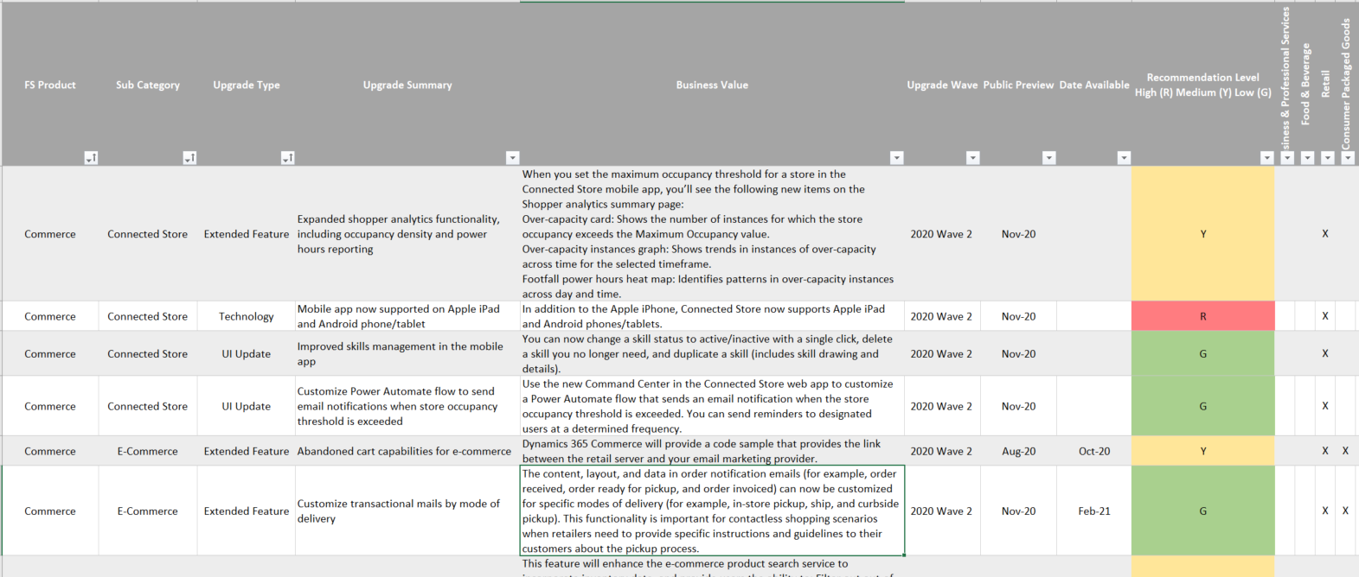
Columns Manually Completed vs. Pulled from Site
Industries

